Slide 1
Max-Planck-Gesellschaft
An independent research organisation

Slide 2



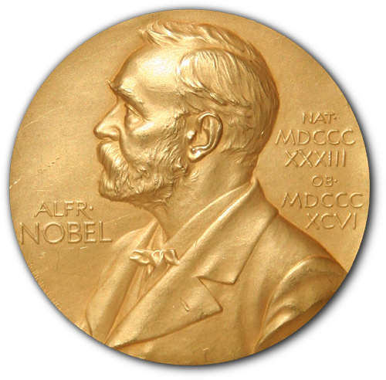








Quick facts
85
MPIs
5
MPIs abroad
18
Max Planck Centers e.g. in the USA, India, Italy
28
Nobel Prizes
31 Nobel Prize Laureates
3rd Place Nature Publishing Index
Top 25
Top Global Innovators of Thomson Reuters
24k Employees
2,1 Billion € Budget (Total federal/state subsidies 2022)
8,000
Junior Scientists from around the world
159
Start-ups
135
Inventions (2021)
1st Place
Most popular employer in the natural sciences

Slide 3
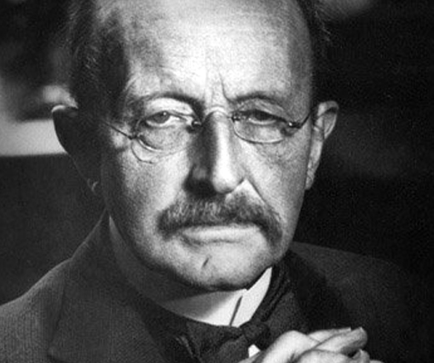

Max Planck Society – founded in 1948
Max Planck (1858-1947)
Founder of the Quantum Theory, Nobel Prize 1918
© MPG

Slide 4
Mission and Guiding Principles
cutting-edge basic research, strictly curiosity-driven and quality oriented
autonomy, scientists decide upon science
Harnack Principle, people not programs
flexible, dynamic, interdisciplinary MPIs
long-term trust systems with significant core funding for high-risk projects
quality assurance by peers
© MPG

Slide 5
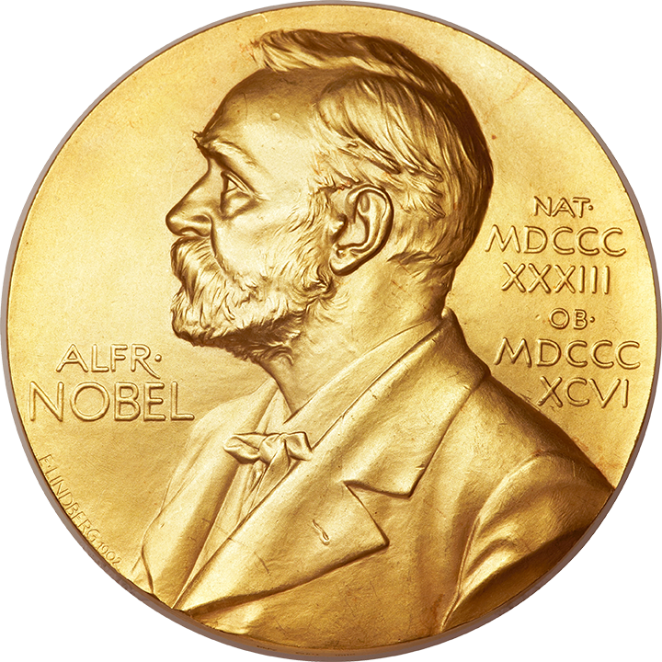
31 Nobel Prize Laureates
__________ who have received the Nobel Prize as a Scientific Member of the MPG/KWG
2023 – Nobel Prize in Physics Ferenc Krausz
2022 – Nobel Prize in Medicine Svante Pääbo
2021 – Nobel Prize for Chemistry Benjamin List
2021 – Nobel Prize in Physics Klaus Hasselmann
2020 – Nobel Prize for Chemistry Emmanuelle Charpentier
2020 – Nobel Prize in Physics Reinhard Genzel
2014 – Nobel Prize for Chemistry Stefan W. Hell
2007 – Nobel Prize for Chemistry Gerhard Ertl
2005 – Nobel Prize in Physics Theodor Hänsch
1995 – Nobel Prize in Medicine Christiane Nüsslein-Volhard
1995 – Nobel Prize for Chemistry Paul Crutzen
1991 – Nobel Prize in Medicine Erwin Neher
1991 – Nobel Prize in Medicine Bert Sakmann
1988 – Nobel Prize for Chemistry Robert Huber
1988 – Nobel Prize for Chemistry Hartmut Michel
1988 – Nobel Prize for Chemistry Johann Deisenhofer*
1986 – Nobel Prize in Physics Ernst Ruska
1985 – Nobel Prize in Physics Klaus von Klitzing
1973 – Nobel Prize in Medicine Konrad Lorenz
1967 – Nobel Prize for Chemistry Manfred Eigen
1964 – Nobel Prize in Medicine Feodor Lynen
1963 – Nobel Prize for Chemistry Karl Ziegler
1954 – Nobel Prize in Physics Walter Bothe
1944 – Nobel Prize for Chemistry
Otto Hahn
1939 – Nobel Prize for Chemistry
Adolf Butenandt
1938 – Nobel Prize in Medicine
Richard Kuhn
1936 – Nobel Prize for Chemistry
Peter Debye
1931 –Nobel Prize in Medicine Otto Warburg
1921 – Nobel Prize in Physics
Albert Einstein
1918 – Nobel Prize for Chemistry
Fritz Haber
1915 – Nobel Prize for Chemistry
Richard Willstätter
* In 1988, the year the prize was awarded, Deisenhofer accepted a call to the University of Texas, USA. He had carried out the Nobel Prize-winning research a few years earlier together with Hartmut Michel and Robert Huber at the Max Planck Institute for Biochemistry, Martinsried.

Slide 6

8 Nobel prize Laureates
__________ who have done research at the MPG/KWG
2009 – Nobel Prize for Chemistry Ada Yonath
1984 – Nobel Prize in Medicine
Georges Köhler
1935 – Nobel Prize in Medicine
Hans Spemann
1932 – Nobel Prize in Physics
Werner Heisenberg
1925 – Nobel Prize in Physics
James Franck
1922 – Nobel Prize in Medicine
Otto Meyerhof
1918 – Nobel Prize in Physics Max Planck
1914 – Nobel Prize in Physics
Max von Laue

Slide 7
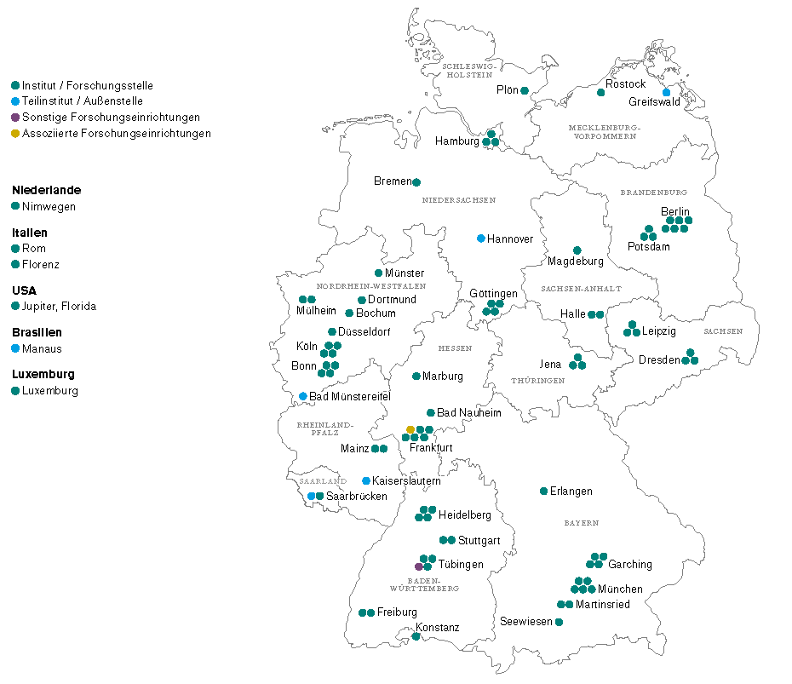
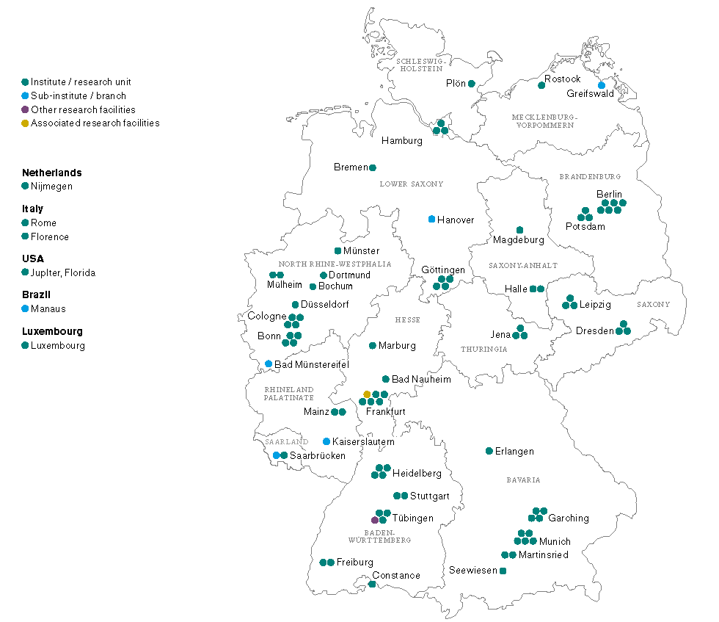
Sites of Max Planck Institutes & ASSOCIATED INSTITUTES 10/2023
MAX PLANCK INSTITUTES ABROAD

Slide 8
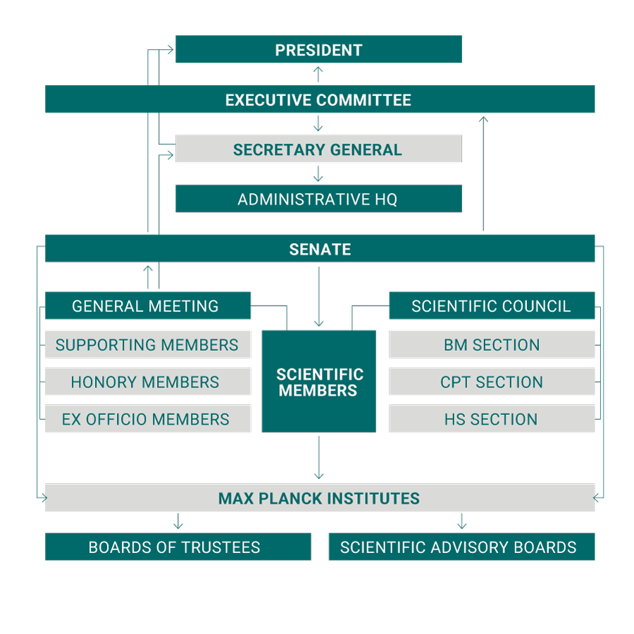
Organizational structure of the Max Planck Society An independent, non-profit research organization and a registered association.
Individual governing bodies within the Max Planck Society make the decisions required to ensure that this large research organization functions efficiently.
Members of the Max Planck Society include the Supporting Members, the Honorary Members, and the ex-officio Members. Other members include the appointed Scientific Members to the Society, who are usually institute directors.

Slide 9
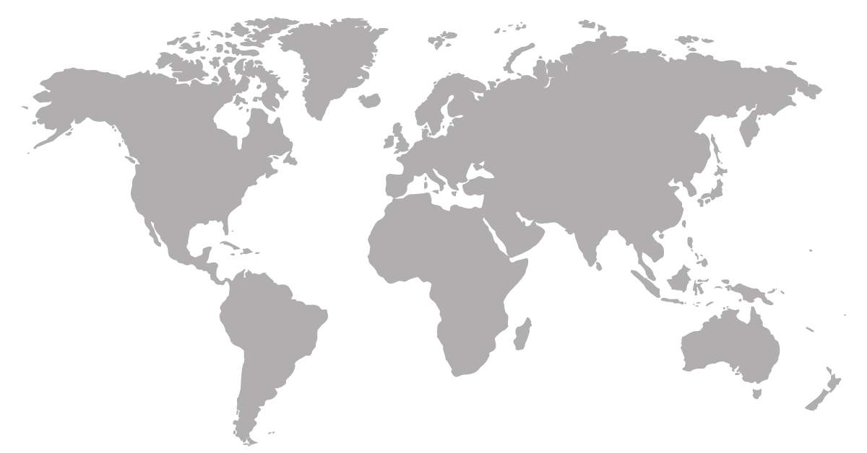

Research knows no Boundaries
Increases the access to outstanding research institutions and experts
Attracts top scientists
Increases opportunities for junior scientists and researchers
Supports the development of new research approaches
Internationality is a central characteristic of research
and a key prerequisite for its success.

Slide 10
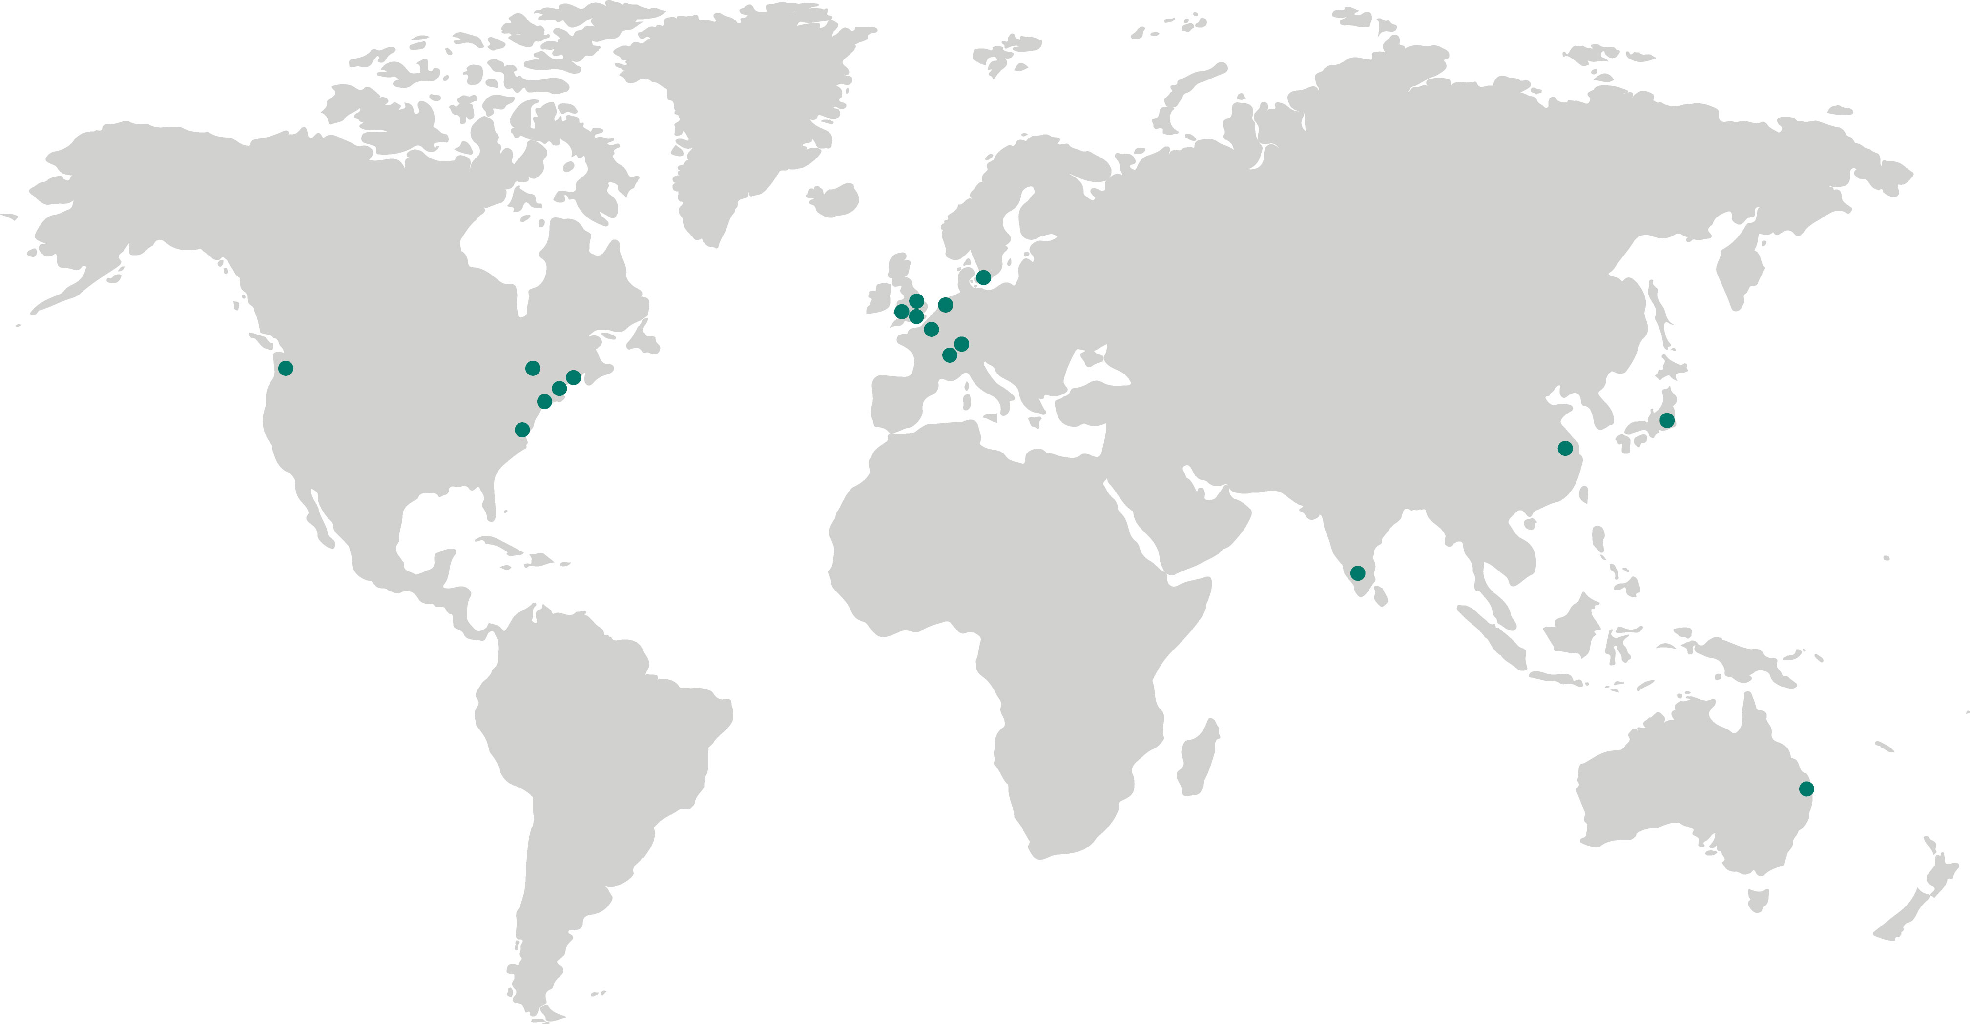
MAX PLANCK CENTERs AND PARTNER INSTITUTES 03/2022

Slide 11
INTERNATIONAL BACKGROUND of Max Planck Scientific Staff as per 31.12.2022; without Florida, Luxemburg, ESI
Proportion of International Scientific Staff
Directors from outside Germany | 304 117 | 38,5%
Max Planck Research Group Leaders (W2) from outside Germany | 386 184 | 47,7%
Postdocs (with TVöD contract and scholarship) from outside Germany | 2.552 1.957 | 76,7%
PhD students (with funding agreement and scholarship) from outside Germany | 3.723 2.338 | 62,8%
Visiting researchers from outside Germany | 2. 798 1.628 | 58,2%

Slide 12
International COLLABORATION Instruments und Infrastructure (4/2023)
Max Planck Centers (18)
Partner Institutes (1) / MPI abroad (5)
Research Infrastructure (9)
Research Groups (2)
Independent / Tandem Groups (18)
Helsinki
Lund
Zotino, ZOTTO
Cardiff, Bristol, London
Nijmegen
ASIA 48 Partner Groups
India 24
China 18
Korea 4
Bhutan 1
Singapore 1
EUROPE 20 Partner Groups
Czech Republic 1
Cyprus 2
Estonia 1
Greece 2
Hungary 1
Israel 1
Italy 3
Poland 1
Slovenia 1
Spain 6
Turkey 1
Vancouver
Nijmegen,Twente
Warschau/Krakau
Toronto
Ottawa
Luxembourg
Geneva, ATLAS
Grenoble, IRAM
Lausanne/Zurich
Washington, Boston, NY (2)
Florence
Arizona, LBT
Calar Alto, CAHA
Rome
Tokyo
Hawaii, PanSTARRS
Jupiter, FL
La Palma, MAGIC Tenerife, Solar Telescopes
NORTH AMERICA 2 Partner Groups
Canada 1
USA 1
Colombia (7)
Manaus, ATTO
LATIN AMERICA 16 Partner Groups
Argentina 2
Bolivia 1
Brazil 3
Chile 4
Colombia 2
Mexico 2
Peru 1
Uruguay 1
AFRICA 7 Partner Groups
Ethiopia 1
RSA 1
Kenya 1
Mali 1
Senegal 1
Tanzania 1
Uganda 1
Tandem Groups (18)
Namibia, H.E.S.S.
Brisbane
Brazil (4)
Uruguay (6)
Buenos Aires
Density collaborations/projects as per 2022
Chile (1)
Argentina
<600 <400 <200 <100 <50 <20

Slide 13
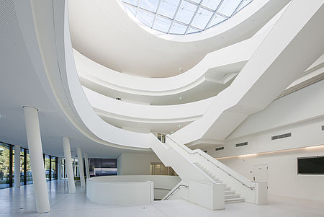
Max Planck Principles Each Max Planck Institute / each Director
… has his/her own budget
… recruits staff
… procures third-party funds
… selects research topics
… identifies cooperation partners in Germany and abroad
… shapes research structures (projects/departments)
© MPL, Florian Trykowski

Slide 14

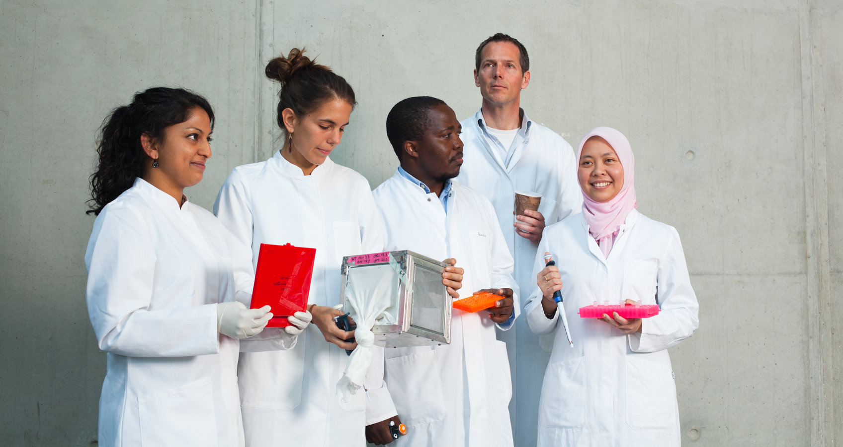
Equal Opportunities Programmes
Lise Meitner Excellence Program
Minerva-FemmeNet (Mentoring Network)
Minerva Fast Track Program
Elisabeth-Schiemann-Kolleg
Sign Up! Careerbuilding
© MPG

Slide 15
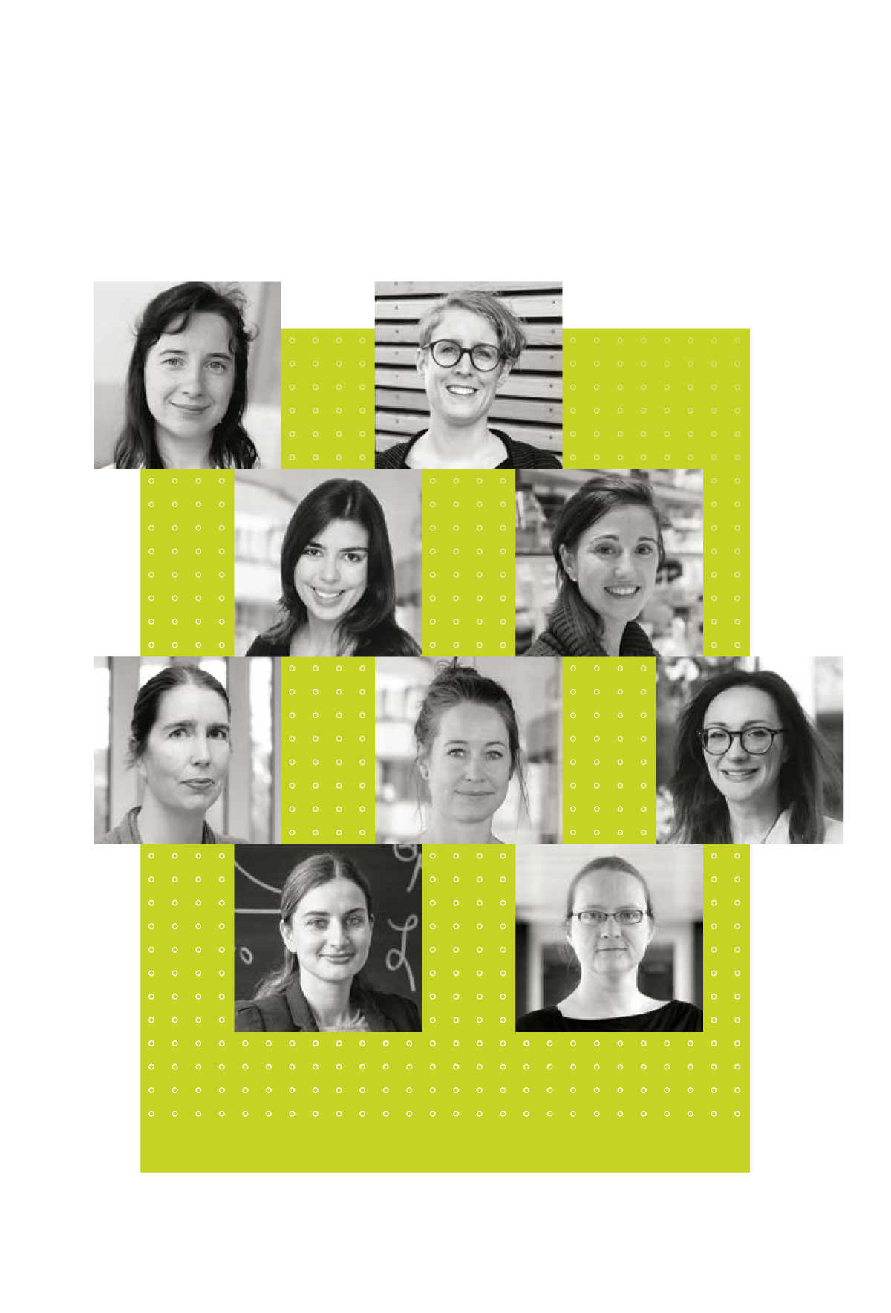
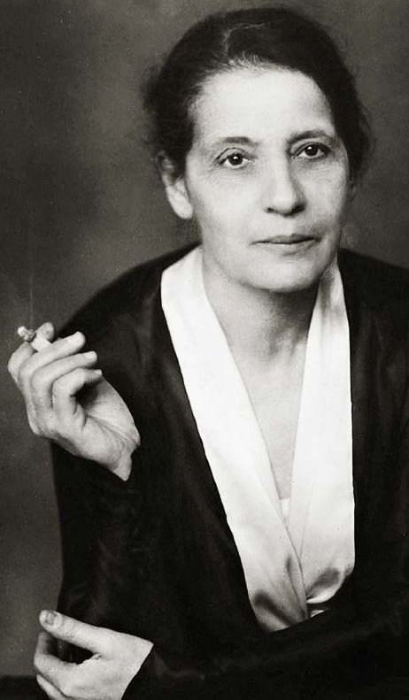
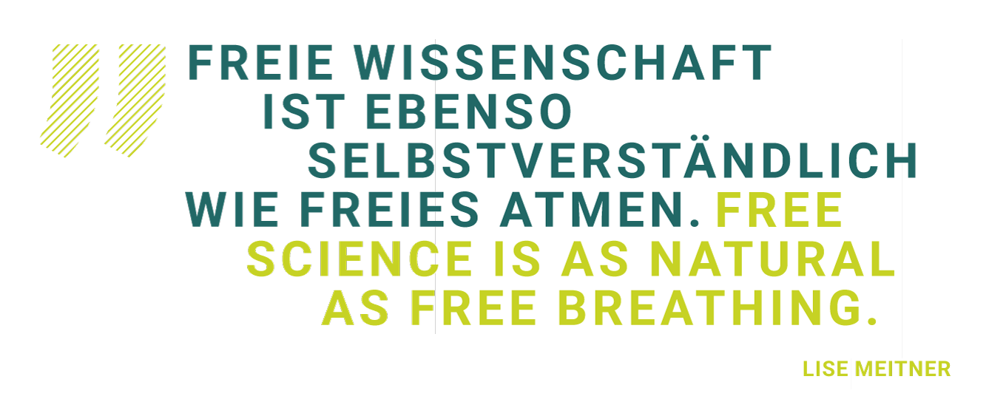
Lise Meitner ExCellence program Recruiting and promoting exceptionally qualified female scientists
free scientific development
long-term professional security
clear career perspectives
© MPG
Lise Meitner (1878-1968)

Slide 16
Career Perspectives: Max Planck Research Group Leaders Where do they go?
Max Planck Research Groups offer junior scientists with a doctoral degree an excellent opportunity to qualify for a further career at a high level.
Max Planck Group Leaders are appointed by the President and (similar to directors at Max Planck Institutes) enjoy an independent status.
There are 194 Max Planck Research Groups.
Max Planck Research Group Leaders are from all over the world, a significant number of them comes from the top 20 universities in the Shanghai Ranking.
as per 31.12.2020
11 % Continuation at the MPI (amongst others, in W2 positions)
10 % MPI Director (Scientific Member)
59 % W2/W3 Positions at universities (national & international)
20 % In other scientific institutions; economy/other

Slide 17
SCIENTIFIC Sections
Biology and Medicine
Section
Chemistry, Physics, and Technology Section
Humanities and Social Sciences Section

Slide 18

Biology and Medicine Section
Developmental and Evolutionary Biology & Genetics
Immunobiology and Infection Biology & Medicine
Behavioural Sciences
Microbiology & Ecology
Neurosciences
Plant Research
Structural and Cell Biology
Physiology

Slide 19

Chemistry, Physics and Technology Section
Astronomy & Astrophysics
Chemistry
Solid State Research & Material Sciences
Earth Sciences and Climate Research
Particle, Plasma and Quantum Physics
Complex Systems
Computer Science
Mathematics

Slide 20

Human Sciences Section
Cultural Studies
Jurisprudence
Social Sciences
Cognitive Research
Linguistics

Slide 21
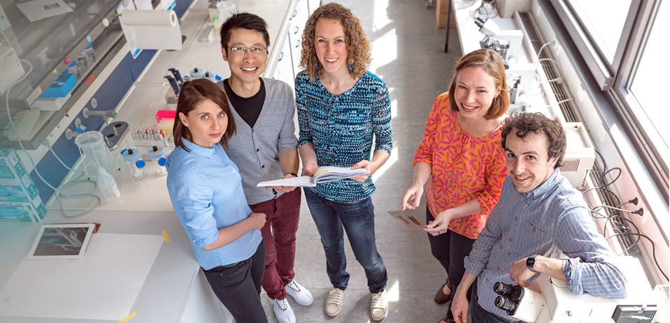
IMPRS – InternationAl Max Planck Research Schools 69 IMPRS with more than 3.000 PhD students (01/2023)
structured PhD student training in collaboration with universities
80 Max Planck Institutes involved
36 German universities involved
about 55 % of PhD students are from outside Germany
© Sabine Jakobs

Slide 22
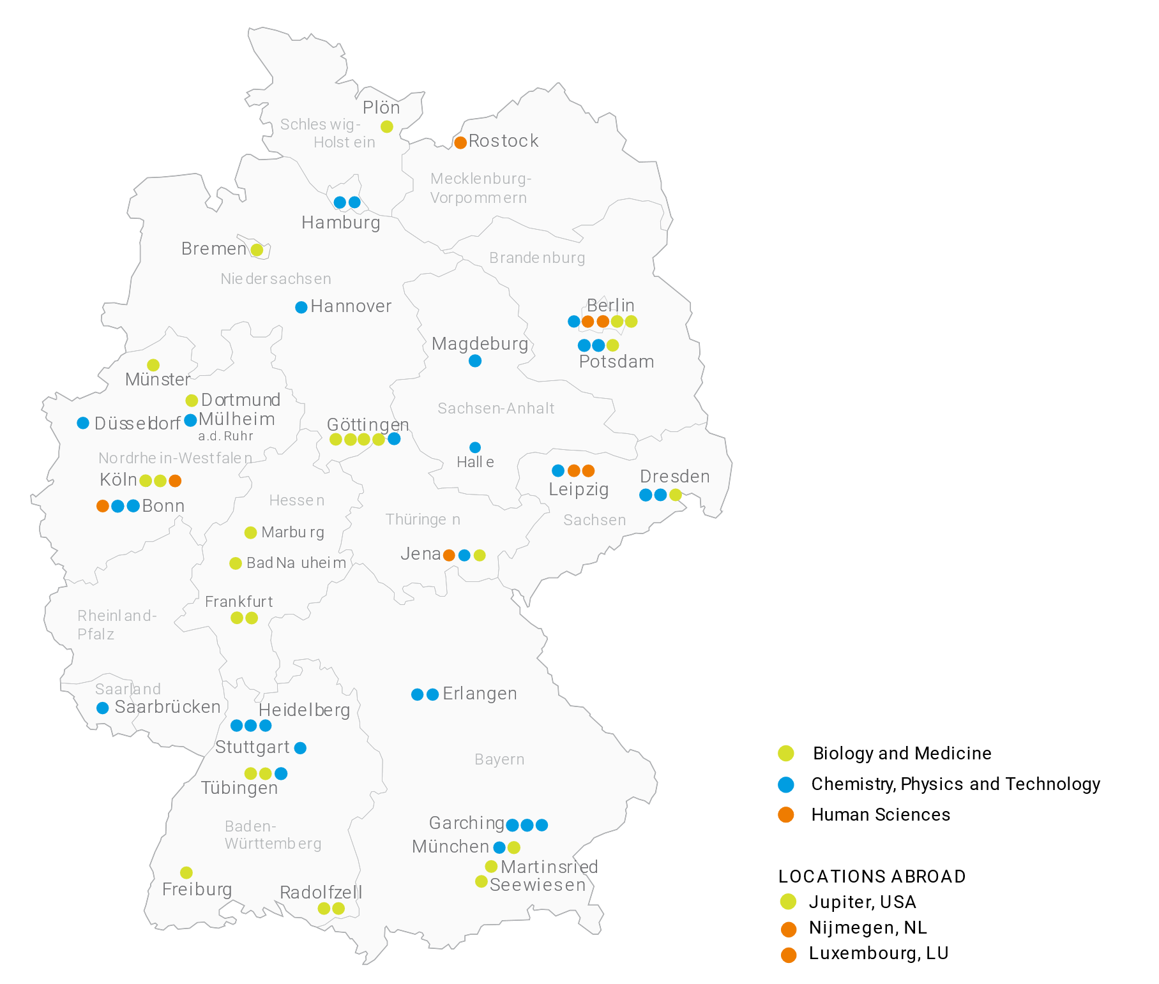
IMPRS Locations 69 IMPRS (as per 01/2023)
LOCATIONS ABROAD
Jupiter, USA Nijmegen, NL Luxemburg, LU

Slide 23
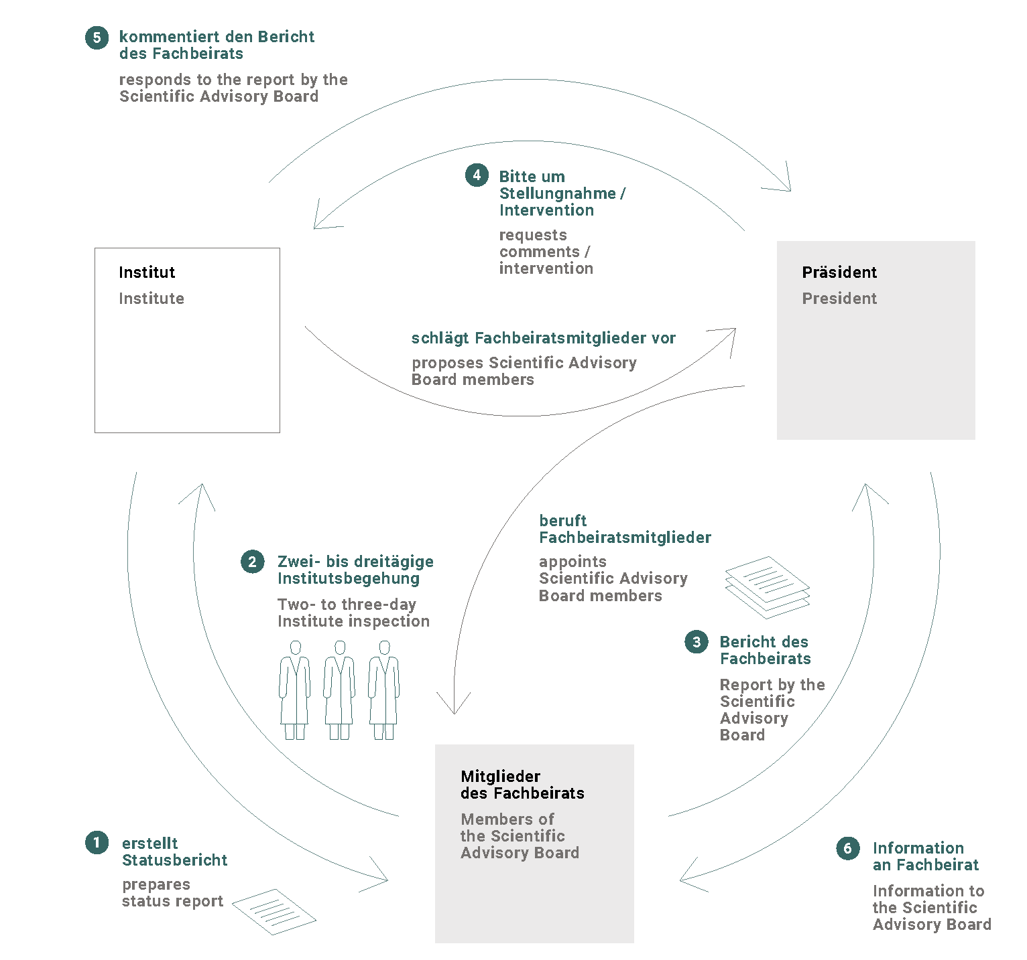
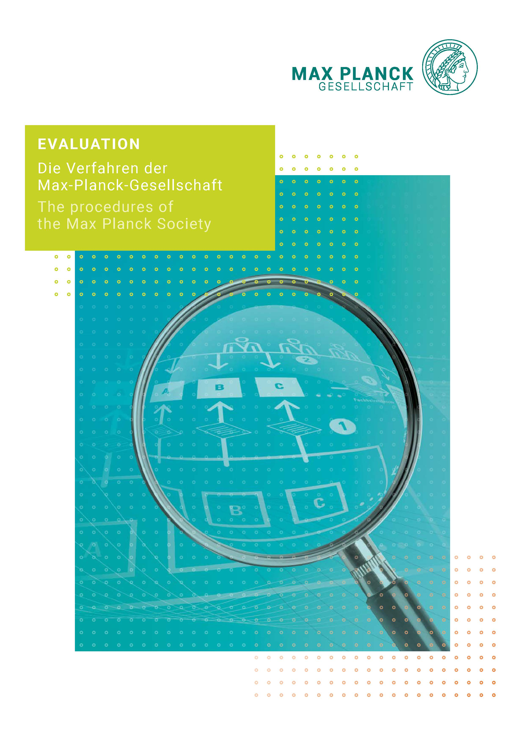
Evaluation Procedures Ex-Post Evaluation

Slide 24
Many Thanks for your Attention! Please contact us if you have any questions.
Max-Planck-Gesellschaft zur Förderung der Wissenschaften e.V.
Communication Department Hofgartenstr. 8, 80539 Munich
Phone: +49 (0)89 2108-1276 Fax: +49 (0)89 2108-1207
Email: presse@gv.mpg.de Internet: www.mpg.de

